Slide 1
Compare/Contrast Entry
Comparing Nonfiction Texts

Slide 2
Step 1: Select the 2 texts
article v. article
or
article v. video

Slide 3
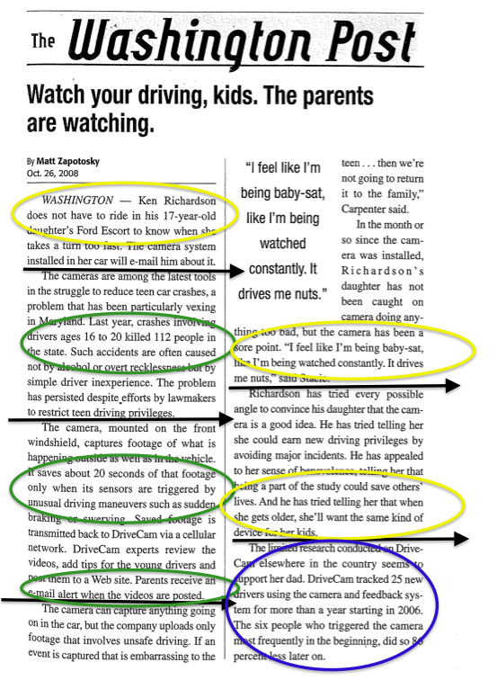
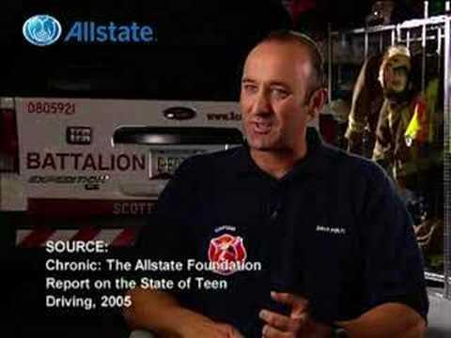
Our Example

Slide 4
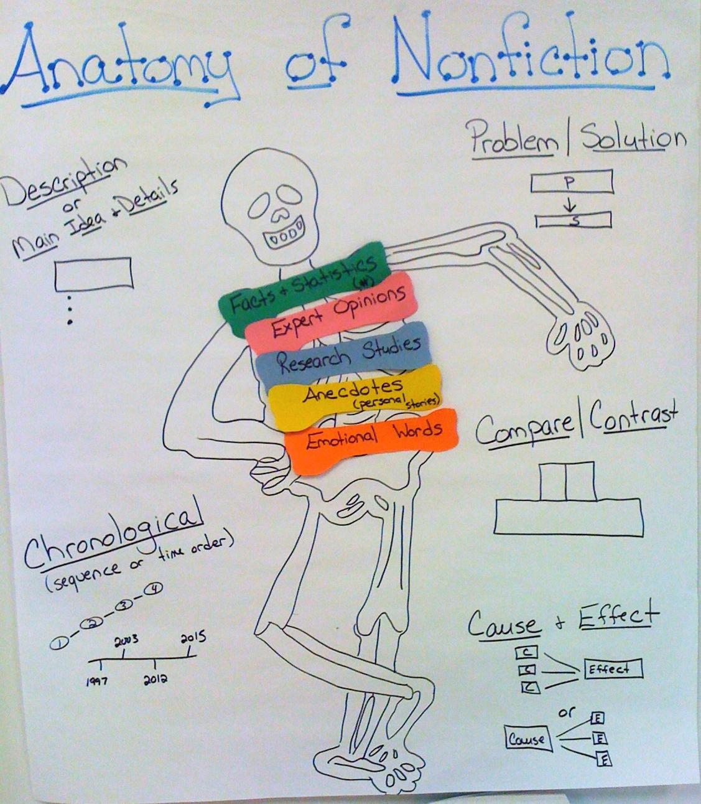
Step 2: Determining Criteria (focus on one at a time)
What kind of evidence does each author present?
How does each author organize their text?
Does one text seem stronger or more believable? Ask yourself, “Why?”

Slide 5
Step 3: Write
Lead Sentence: (2 texts, compare/contrast term, criteria)
One way that “Watch Your Driving, Kids” and the Allstate Foundation video are similar is the way the author structures each text.

Slide 6
Evidence from Text #1
One way that “Watch Your Driving, Kids” and the Allstate Foundation video are similar is the way the author structures each text. In the second paragraph of “Watch Your Driving Kids,” the author gives statistics about how many deaths are caused by teen car crashes in Maryland. Then later in the article, the author presents DriveCam as a possible solution to this problem.

Slide 7
Evidence from Text #2
One way that “Watch Your Driving, Kids” and the Allstate Foundation video are similar is the way the author structures each text. In the second paragraph of “Watch Your Driving Kids,” the author gives statistics about how many deaths are caused by teen car crashes in Maryland. Then later in the article, the author presents DriveCam as a possible solution to this problem.In the Allstate Foundation video, the experts from Allstate also give statistics about the dangers of teen driving, and then say that they want to help give teens that extra one-second advantage that may save their lives.

Slide 8
Compare/Contrast Sentence
One way that “Watch Your Driving, Kids” and the Allstate Foundation video are similar is the way the author structures each text. In the second paragraph of “Watch Your Driving Kids,” the author gives statistics about how many deaths are caused by teen car crashes in Maryland. Then later in the article, the author presents DriveCam as a possible solution to this problem.In the Allstate Foundation video, the experts from Allstate also give statistics about the dangers of teen driving, and then say that they want to help give teens that extra one-second advantage that may save their lives. Both texts begin by explaining a problem, and then they provide a solution.

Slide 9
Explanation
Ask youself:
Why would the authors use this type of evidence?
What does each author stand to gain?
Is he selling something?
Who is benefiting from this information?
3. Are the authors presenting both sides of the issue?

Slide 10
Explanation
One way that “Watch Your Driving, Kids” and the Allstate Foundation video are similar is the way the author structures each text. In the second paragraph of “Watch Your Driving Kids,” the author gives statistics about how many deaths are caused by teen car crashes in Maryland. Then later in the article, the author presents DriveCam as a possible solution to this problem.In the Allstate Foundation video, the experts from Allstate also give statistics about the dangers of teen driving, and then say that they want to help give teens that extra one-second advantage that may save their lives. Both texts begin by explaining a problem, and then they provide a solution. This shows how authors can use statistics to get the audience to care about the solutions they want to present.

